Slide 1
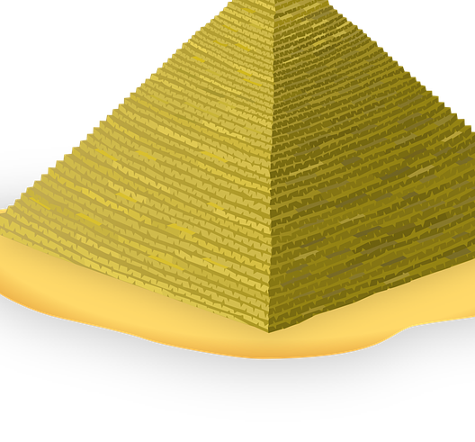
Ancient Egypt Facts
Ancient Egypt was a civilization in northeast Africa.
Ancient Egypt lasted from 3150 to 30 BCE, about 3000 years.
Historians divide Ancient Egypt into three main periods.
The capital city of Egypt has been changed multiple times.
The Ancient Egyptians left behind many monuments, like →
The Nile River helped Ancient Egyptians survive.
The Rosetta Stone helped historians to read hieroglyphs.
Ancient Egyptians believed in an afterlife.
Ancient Egyptians grew crops in the fertile soil in near the Nile River.

Slide 2
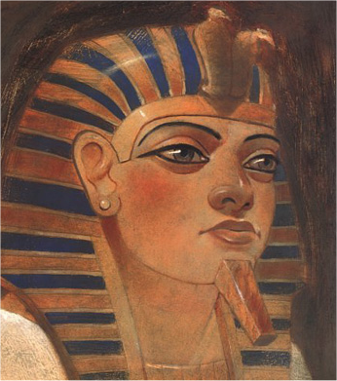
Queen Hatshepsut
Queen Hatshepsut was born on 1538 BCE and died on 1458 BCE, living around 80 years old.
Queen Hatshepsut's death was unknown.
She held dominant power for more than 20 years.
Queen Hatshepsut was a female ruler/pharaoh.
She called herself a king and a male.
She was married to Tutmose II, her step brother.
She had 4 other names people referenced her as, such as, God’s Wife, and King’s Sister.
She was a dominant ruler until Year 20.
Queen Hatshepsut had at least one Senmut (Or Architect)
Hatshepsut had a daughter with her own step-brother, named Princess Ranefru.
Thutmose III ordered Hatshepsut’s name to be erased from monuments.
Howard Carter had discovered the tomb, KV60, with two unknown female mummies.
She was discovered by scientists after when the scientists took DNA from her tooth in 2007.

Slide 3
Works Cited
“Ancient Egypt” Ancient Egypt, Gale, 2011. Kids InfoBits Presents. Kids InfoBits, Accessed 29, Mar. 2017.
"Hatshepsut." Encyclopedia of World Biography, Gale, 1998. Biography in Context,
link.galegroup.com/apps/doc/K1631002894/BIC1?u=nysl_ro_gatescms&xid=4c2ef1. Accessed 10 Apr. 2017.

